Slide 1
MiniDraw
Introducing a Framework
... and a few patterns

Slide 2
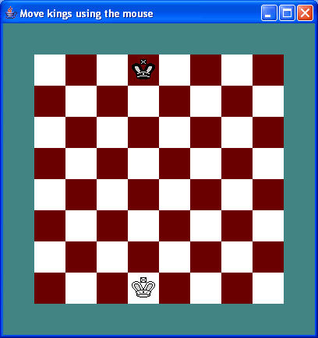
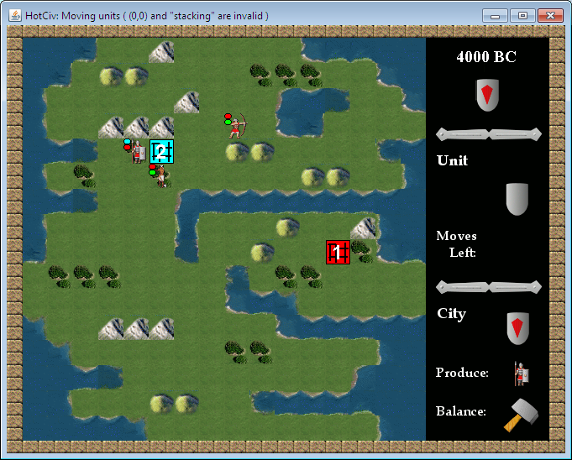
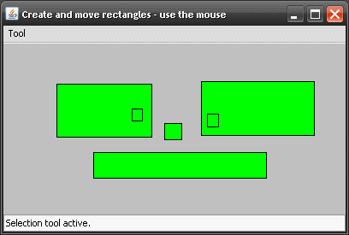
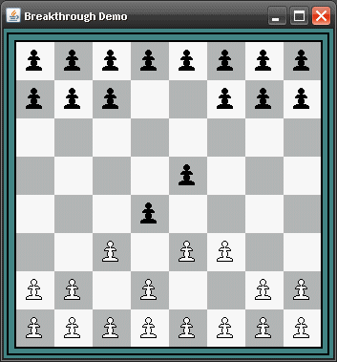
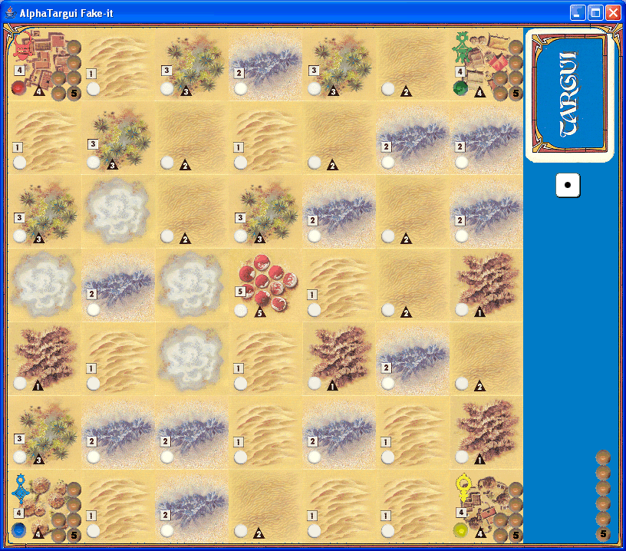
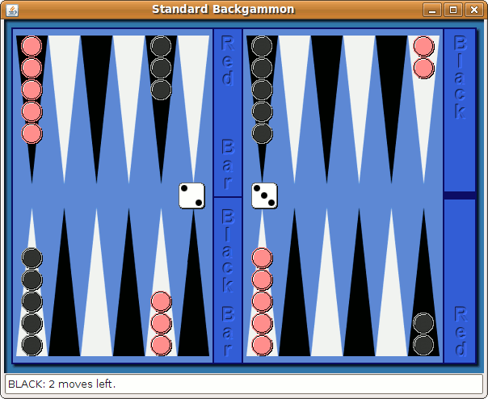
What is it?
[Demo]
DAIMI
Henrik Bærbak Christensen

Slide 3
What do I get?
MiniDraw helps you building apps that have
  2D image based graphics
    GIF files
    Optimized repainting
  Direct manipulation
    Manipulate objects directly using the mouse
  Semantic constraints
    Keep objects semantically linked
DAIMI
Henrik Bærbak Christensen

Slide 4
History
MiniDraw is downsized from JHotDraw
JHotDraw
  Thomas Eggenschwiler and Erich Gamma
  Java version of HotDraw
HotDraw
  Kent Beck and Ward Cunningham.
  Part of a smalltalk research project that lead to the ideas we now call design patterns and frameworks
DAIMI
Henrik Bærbak Christensen

Slide 5
MiniDraw
MiniDraw
  supporting board games mainly
  cut down detail for teaching purposes
  one day convert to C# (hmm ?)
  MiniDraw: compositional design (most of the time)
  JHotDraw: polymorphic design (quite a lot of the time)
Newest addition
  BoardGame extension:
    High support for board games
DAIMI
Henrik Bærbak Christensen

Slide 6

Our first MiniDraw application

Slide 7
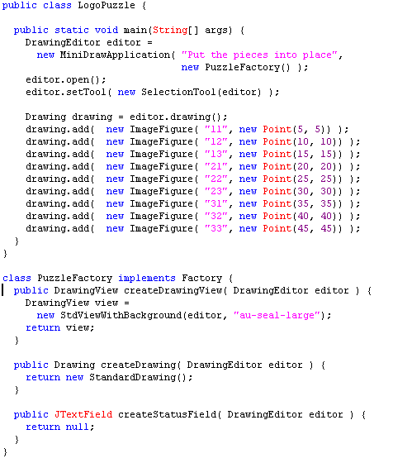


DrawingEditor
  “Project manager”/Redaktør
  Default implementation
Figure
  Visible element
  ImageFigure
Drawing
  container of figures
Tool
  = controller
Factory
  create impl. of MiniDraw roles
DrawingView
  view type to use...
DAIMI
Henrik Bærbak Christensen

Slide 8
The Patterns in MiniDraw
Not what but why?
The 3-1-2 principles in action again...

Slide 9
MiniDraw software architecture
Main JHotDraw architecture remains
  Model-View-Controller architectural pattern
    Drawing-DrawingView-Tool
  Observer pattern event mechanism
DAIMI
Henrik Bærbak Christensen

Slide 10
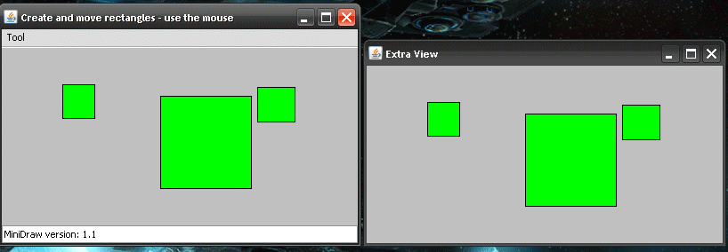
MVC’ problem statement
Challenge:
  writing programs with a graphical user interface
  multiple open windows showing the same data – keeping them consistent
  manipulating data in many different ways by direct manipulation (eg. move, resize, delete, create, ...)
    i.e. switching tool will switch the object manipulation
DAIMI
Henrik Bærbak Christensen

Slide 11
Challenge 1
Keeping multiple windows consistent?
Analysis:
  Data is shared but visualization is variable!
  ③ Data visualisation is variable behaviour
  ① Responsibility to visualize data is expressed in interface: View
  ② Instead of data object (model) itself is responsible for drawing graphics it lets someone else do the job: the views
Model
*
<<interface>>
View
update()
View A
View A
DAIMI
Henrik Bærbak Christensen

Slide 12
Challenge 2
Few mouse events (down, up, drag) translate to open-ended number of actions (move, resize, create, ?) on data.
  Events are the same but manipulation is variable
  ③ Data manipulation is variable behaviour
  ① Responsibility to manipulate data is expressed in interface: Controller
  ② Instead of graphical view itself is responsible for manipulating data it lets someone else do the job: the controller
View
<<interface>>
Controller
mouseDrag()
Move
Select
Model
DAIMI
Henrik Bærbak Christensen

Slide 13
Observer
Challenge 1:
  Also known as observer pattern
Intent
  Define a one-to-many dependency between objects so that when one object changes state, all its dependents are notified and updated automatically.
DAIMI
Henrik Bærbak Christensen

Slide 14

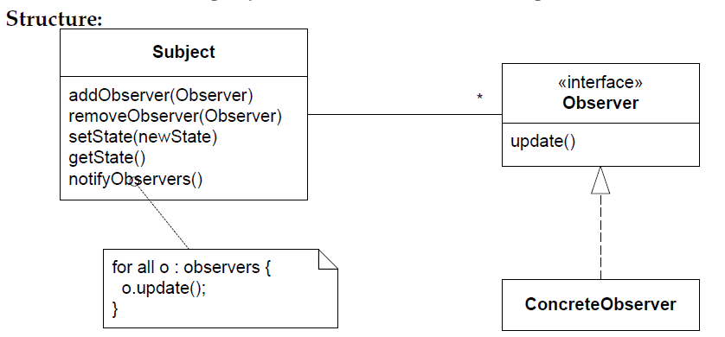
Observer: Structure
DAIMI
Henrik Bærbak Christensen

Slide 15
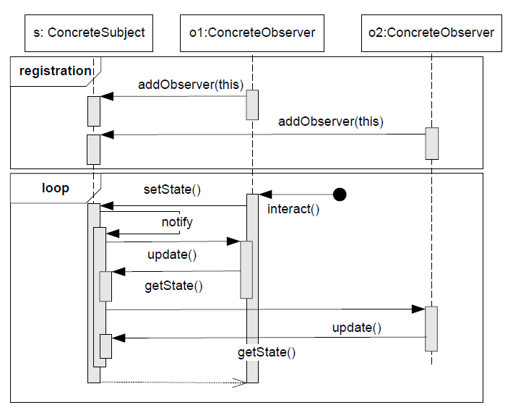
Observer Protocol
Protocol:
A convention detailing the expected sequence of interactions or actions expected by a set of roles.
DAIMI
Henrik Bærbak Christensen

Slide 16
Observer
Benefits
    open ended number of viewer types (run-time binding)
    need not be known at develop time
      change by addition, not by modification...
    any number of views open at the same time when executing
    all guarantied to be synchronized
Liabilities
    update sequence can become cyclic or costly to maintain
DAIMI
Henrik Bærbak Christensen

Slide 17
State
Challenge 2:
  Also known as state pattern
Intent
  Allow an object to alter its behaviour when its internal state changes. The object will appear to change its class.
  i.e. when the editor is in “draw rectangle” state, the mouse events (click, drag, release) will create a rectangle; when in “select object” state, the same (click, drag, release) will move an object…
DAIMI
Henrik Bærbak Christensen

Slide 18
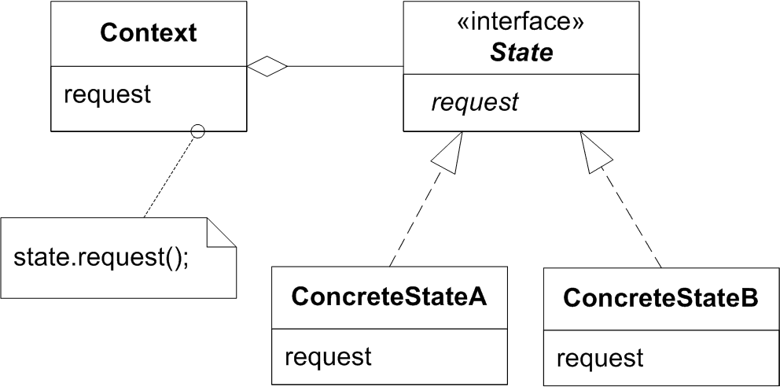
State
Consequences
    the manipulation that is active determine the application state (“am I moving or resizing figures?”)
    open ended number of manipulations (run-time binding)
    need not know all states at compile time
      change by addition...
DAIMI
Henrik Bærbak Christensen

Slide 19
Selected Tool defines the State
In MiniDraw (HotDraw) the editor is in a state that determines how mouse events are interpreted – do they move a checker, do they select a set of figures, or do they create a rectangle?
Mouse events are forwarded to the editor’s tool. By changing the tool I change how mouse events are interpreted.
DAIMI
Henrik Bærbak Christensen

Slide 20
MVC
The MVC is an architectural pattern because it defines a solution to the problem of structuring the ’large-scale’ / architectural challenge of building graphical user interface applications.
But the ’engine behind the scene’ is a careful combination of state and observer...
That again are example of using the 3-1-2 variability handling process.
DAIMI
Henrik Bærbak Christensen

Slide 21
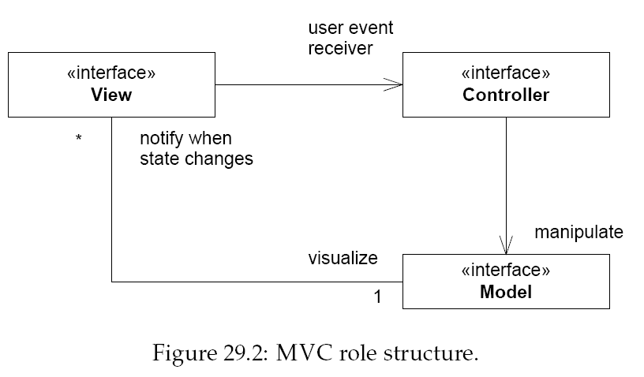
Static view
DAIMI
Henrik Bærbak Christensen

Slide 22
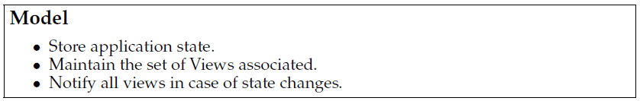
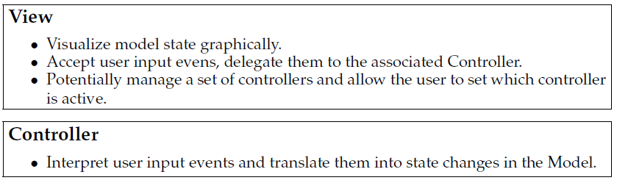
Responsibilities
DAIMI
Henrik Bærbak Christensen

Slide 23
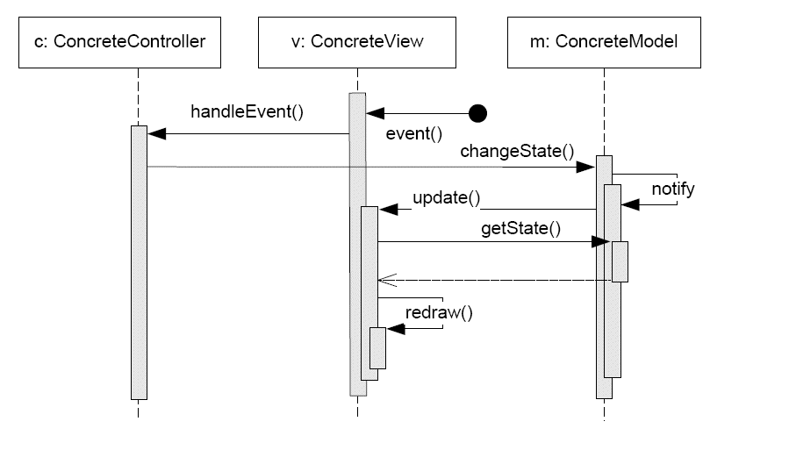
Dynamics

Slide 24
MiniDraw

Slide 25
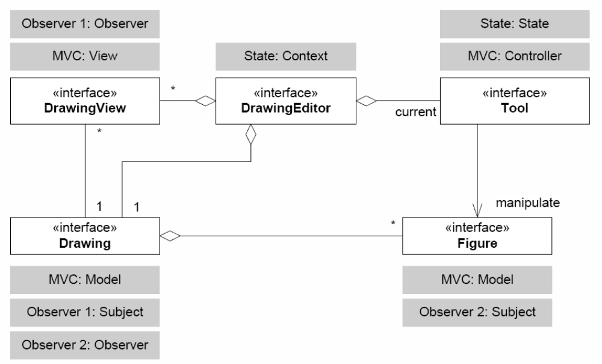
MiniDraw: Static+Pattern View
DAIMI
Henrik Bærbak Christensen

Slide 26
Tool: The Controller role

Slide 27
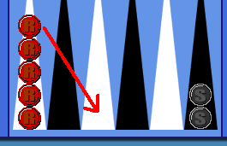
MiniDraw: Tool Interaction
Basic paradigm: Direct Manipulation
[Demo: puzzle]
DAIMI
Henrik Bærbak Christensen

Slide 28
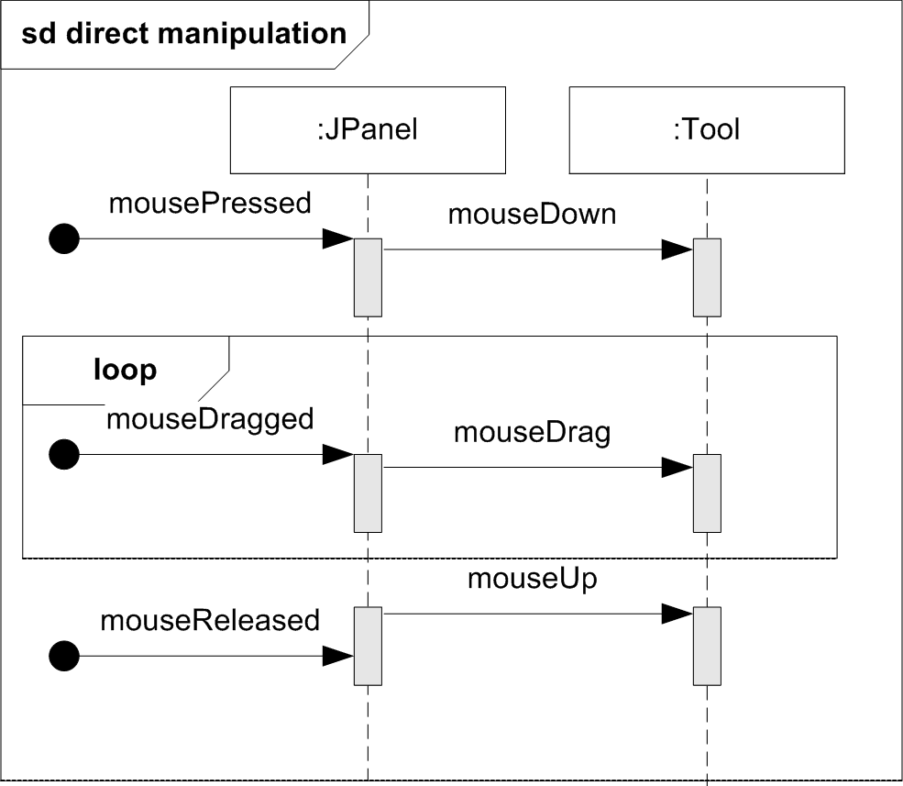
View -> Controller interaction
Mouse events do hit the JPanel, but MiniDraw simply delegate to its active tool...
DAIMI
Henrik Bærbak Christensen

Slide 29
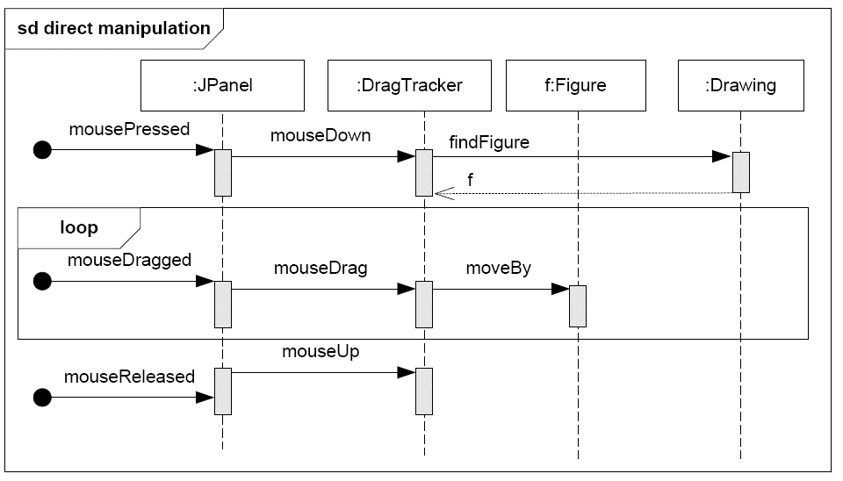
Example Tool
Scenario: User drags image figure around.
Then a DragTracker is the active tool:
DAIMI
Henrik Bærbak Christensen
Notes:
On the mouse down, it spends some time to find the

Slide 30
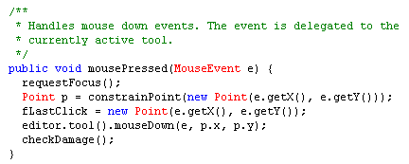
The real story
… is somewhat more complex as it involves a bit more delegation ☺
StandardDrawingView is-a JPanel.
  This view requests access to the editor’s current tool
DAIMI
Henrik Bærbak Christensen

Slide 31
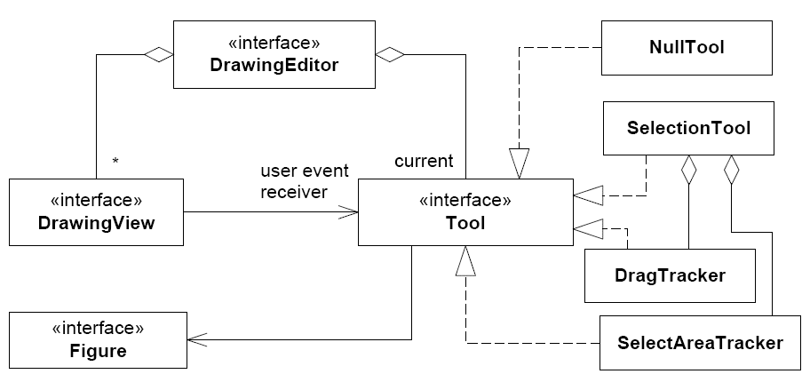
Tools
MiniDraw has some simple tools defined
DAIMI
Henrik Bærbak Christensen

Slide 32
Code view
It is very simple to set a new tool:
editor.setTool( t );
where t is the tool you want to become active.
NullTool is a Null Object: a tool that does nothing.
DAIMI
Henrik Bærbak Christensen

Slide 33
Drawing: The Model role

Slide 34
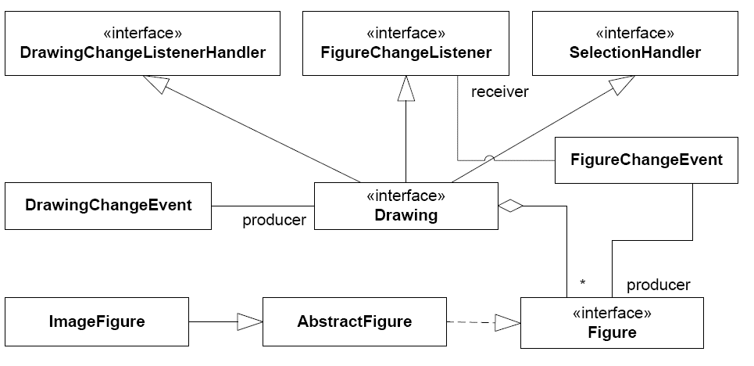
MiniDraw: Drawing
Static view
DAIMI
Henrik Bærbak Christensen

Slide 35
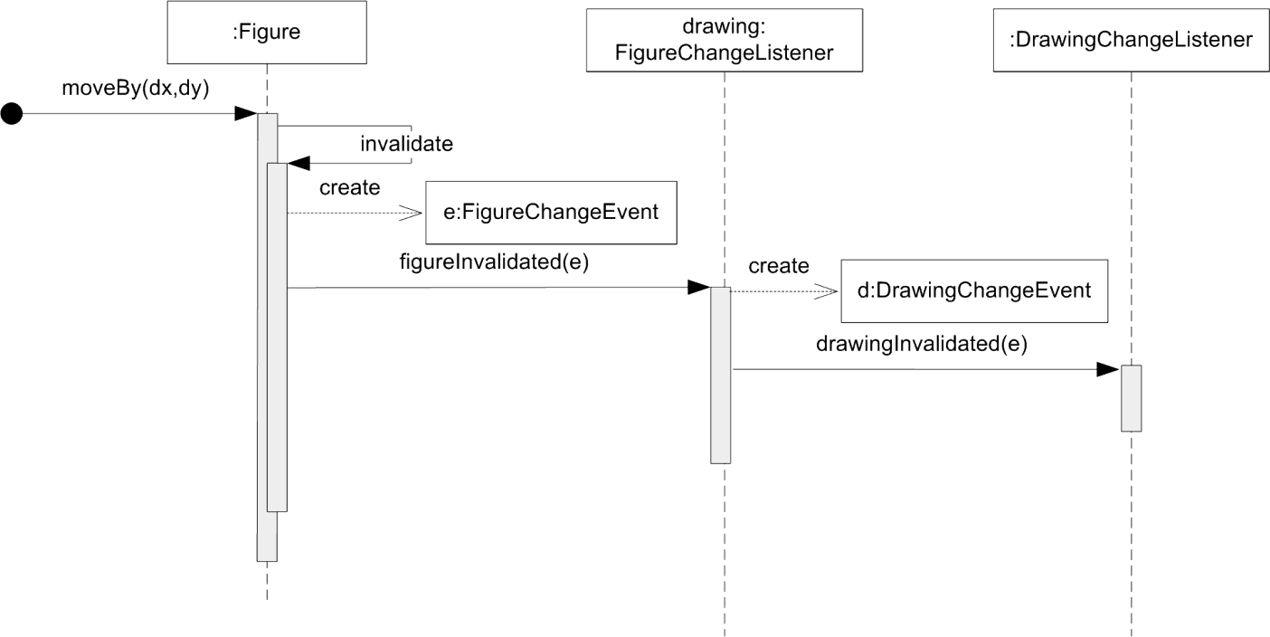
MiniDraw: Drawing
But how does the view get repainted?
  Double observer chain
    Figure notifies drawing notifies drawing view.
DAIMI
Henrik Bærbak Christensen

Slide 36
Exercise:
Observer pattern has two roles
  Subject: Container of data
  Observer: Object to notify upon data changes
Who are who here???
DrawingView
Drawing
Figure
DAIMI
Henrik Bærbak Christensen

Slide 37
DrawingView: The View role

Slide 38
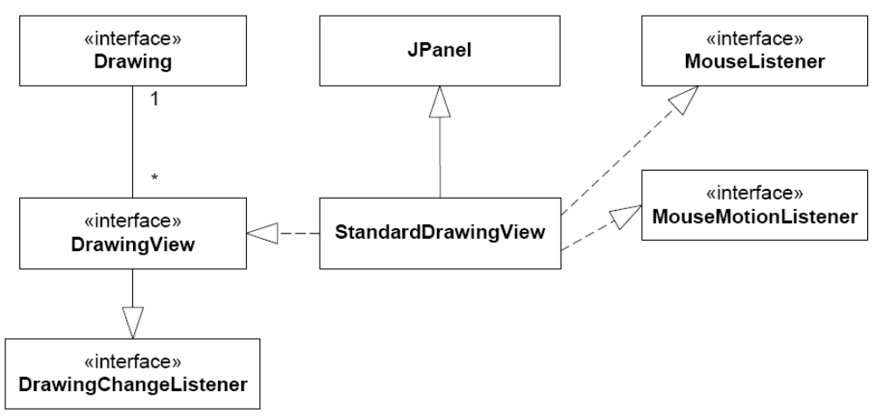
View
The View is rather simple
  JPanel to couple MiniDraw to concrete Swing GUI implementation
  Listen to mouse events to forward them to tool/controller.
DAIMI
Henrik Bærbak Christensen

Slide 39
The Compositional Advantage
Note that this design combines two frameworks
  MiniDraw and Swing
  If DrawingView was not an interface then 

Slide 40
DrawingEditor: The Coordinator

Slide 41
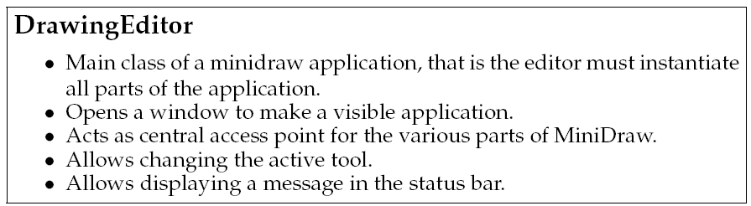
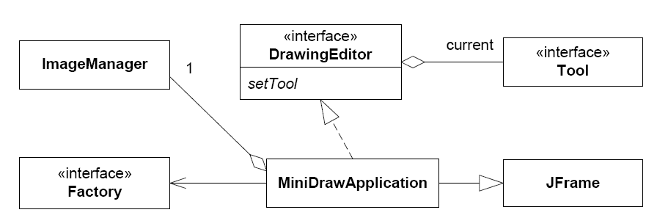
Static View

Slide 42
Implementation

Slide 43
Default Implementations
Most MiniDraw roles have default implementations:
  Interface X has default implementation StandardX
  Drawing -> StandardDrawing
There are also some partial implementations:
  Interface X has partial implementation AbstractX
  Tool -> AbstractTool
  Figure -> AbstractFigure
DAIMI
Henrik Bærbak Christensen

Slide 44
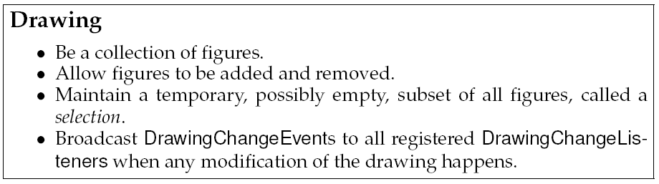
Compositional Design
Complex behaviour as a result of combining simple behaviour...
Example:
  StandardDrawing
  Responsibilities
DAIMI
Henrik Bærbak Christensen

Slide 45
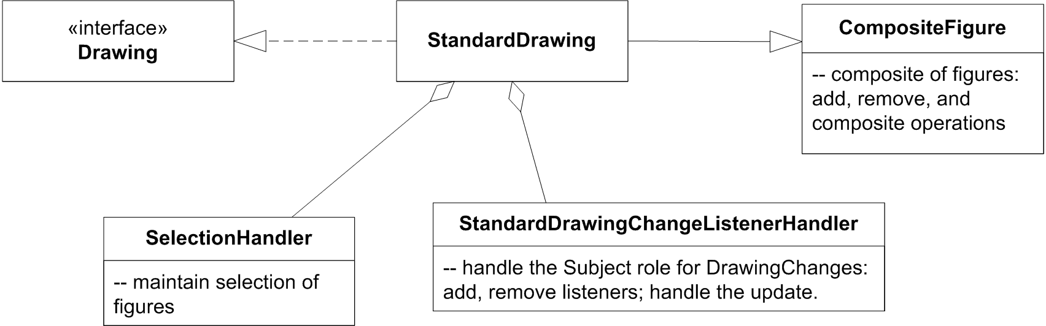
How do we do that?
Proposal 1:
  implement ahead...
Proposal 2:
  encapsulate major responsibilities in separate objects and compose behaviour
Refactoring pending!
DAIMI
Henrik Bærbak Christensen

Slide 46
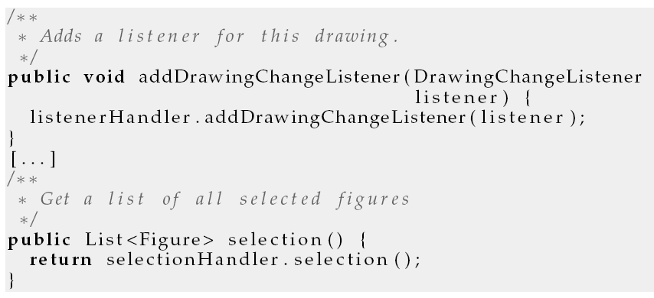
Code view: delegations!
Examples:

Slide 47
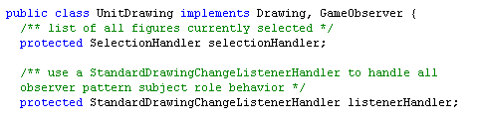
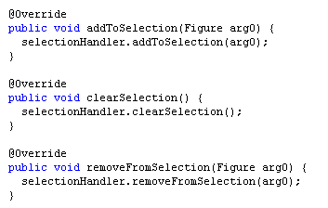
What do I achieve?
Implementing a custom Drawing
  In which the figure collection works differently…
  but I can reuse the selection and drawing-change handler behaviour directly!
DAIMI
Henrik Bærbak Christensen

Slide 48
MiniDraw Variability Points

Slide 49
Variability Points
Images
  By putting GIF images in the right folder and use them through ImageFigures
Tools
  Implement Tool and invoke editor.setTool(t)
Figures
  You may make any new type you wish
Drawing
  Own collection of figures (e.g. observe a game instance)
Observer Figure changes
  Make semantic constraints
Views
  Special purpose rendering

Slide 50
Summary
MiniDraw is
  A framework: A skeleton application that can be tailored for a specific purpose
  A demonstration:
    of MVC, Observer, State, Abstract Factory, Null Object, Strategy, ...
    of compositional design: Make complex behaviour by combining simpler behaviours
  A basis: for the mandatory project GUI.
DAIMI
Henrik Bærbak Christensen

